Slide 1
Giorgio Mondauto
Software Engineer at Optum (UHG)
MSc in Statistics (UCD)

Slide 2
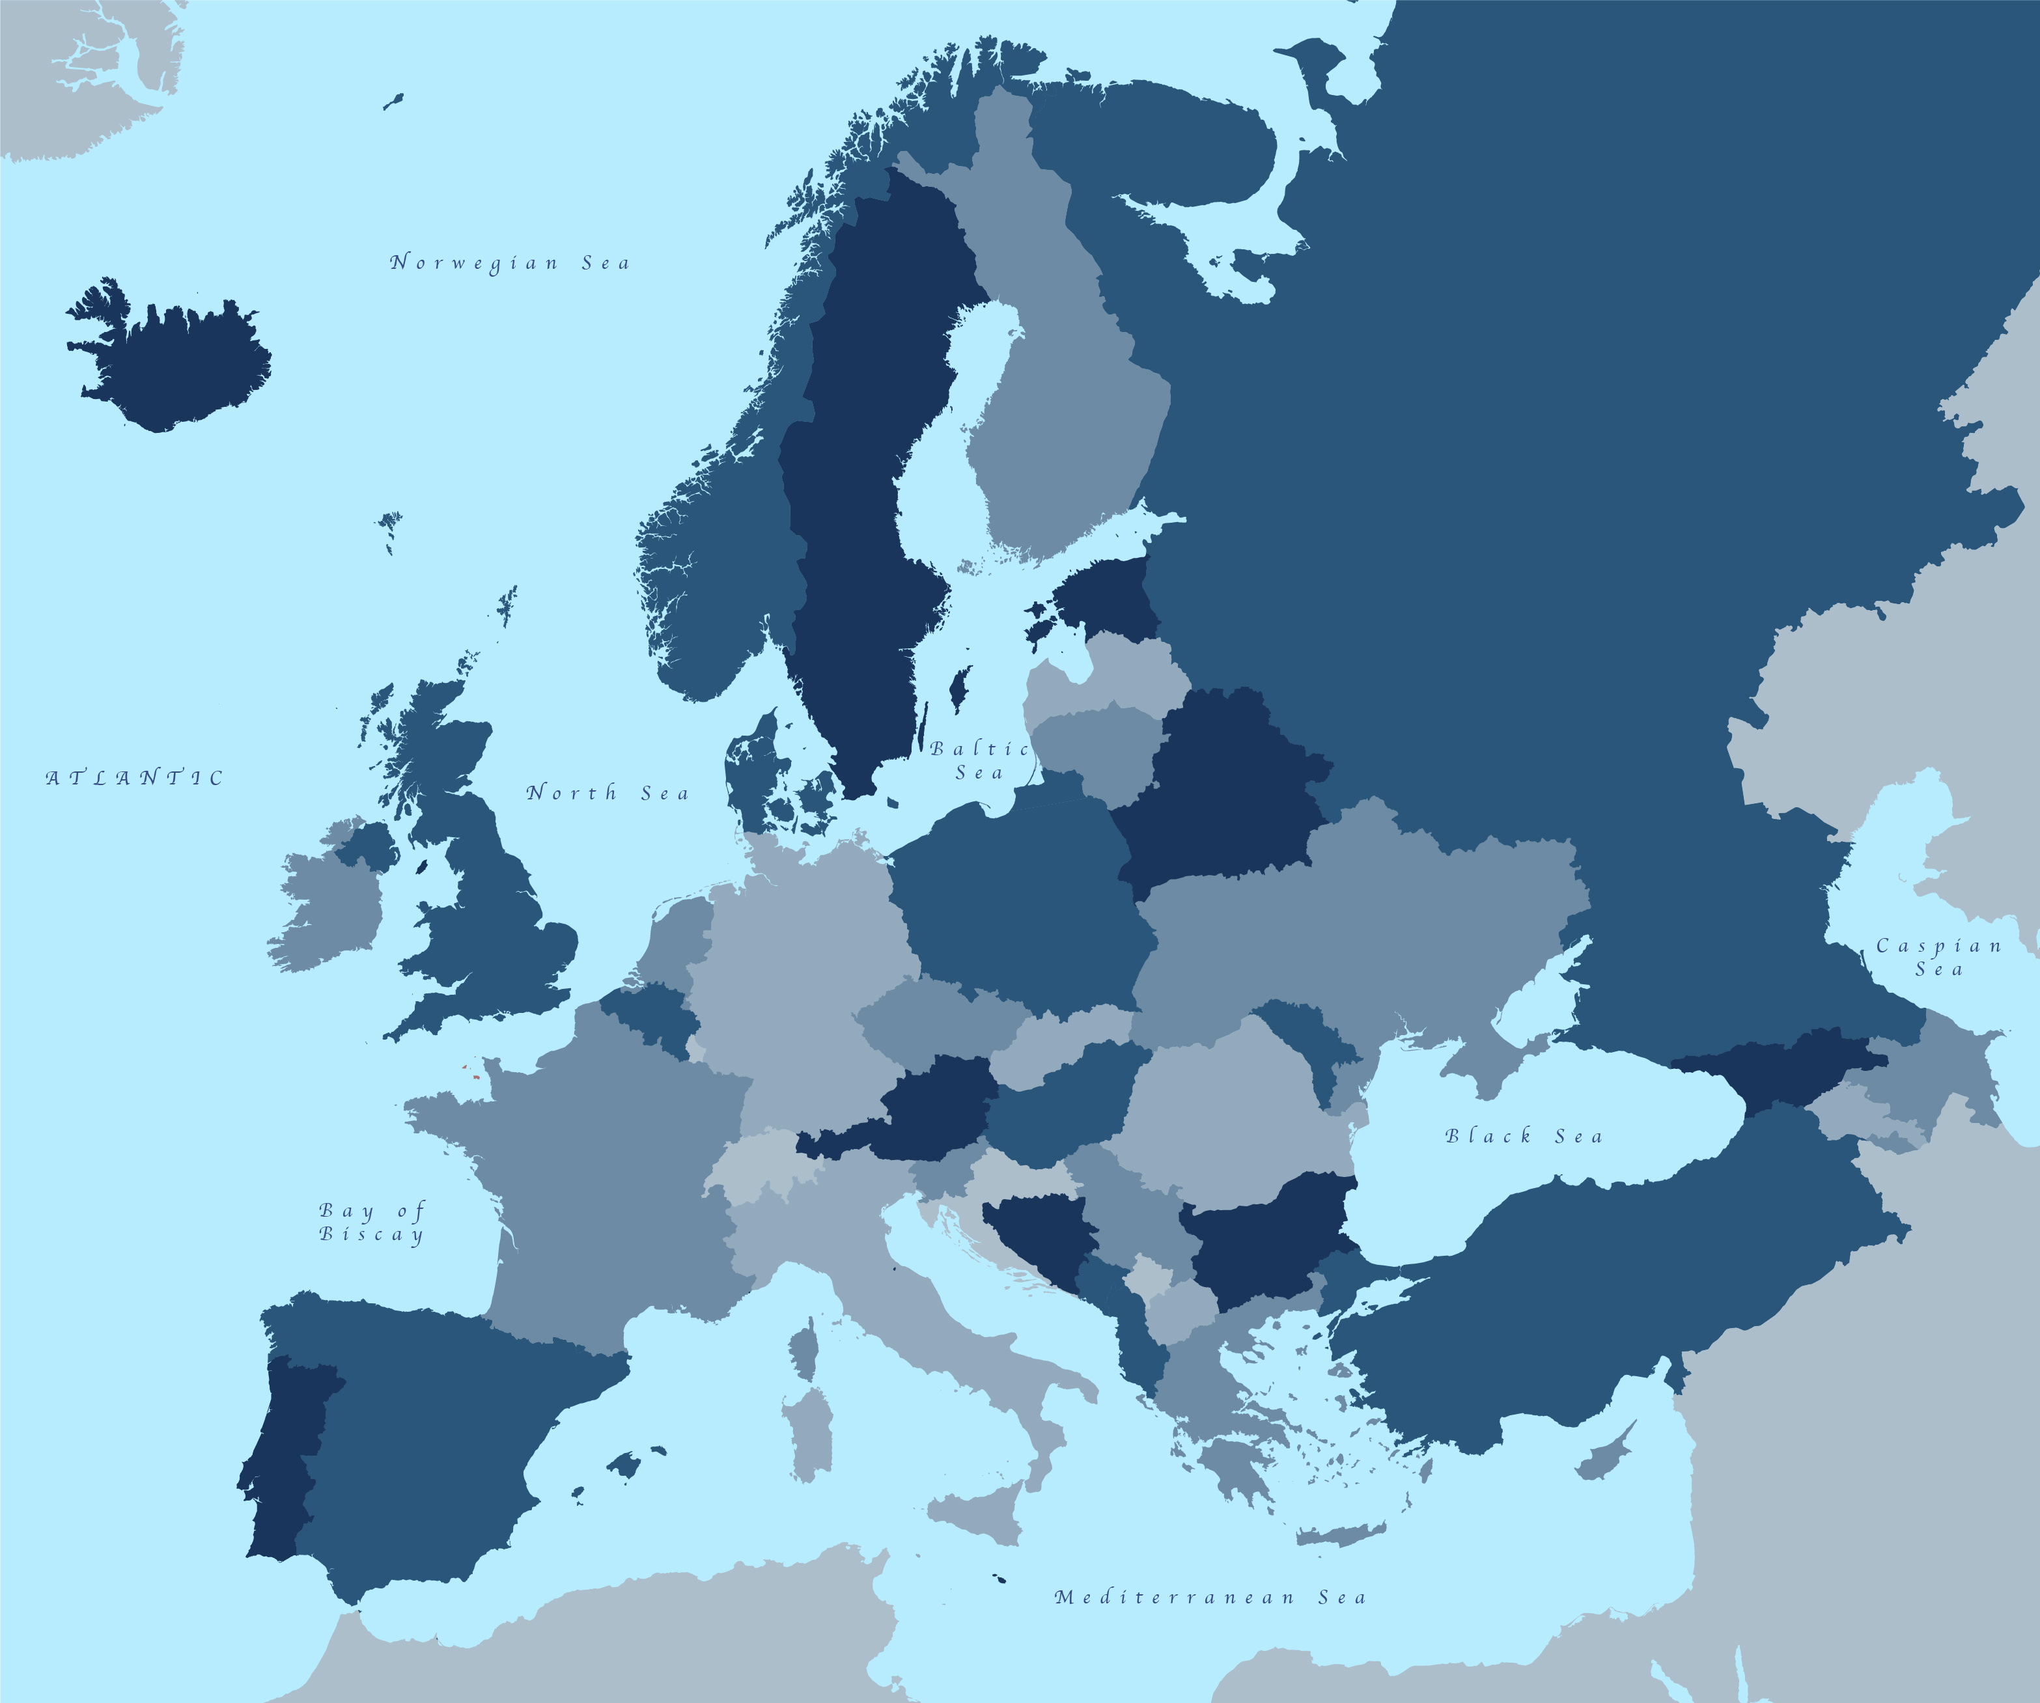
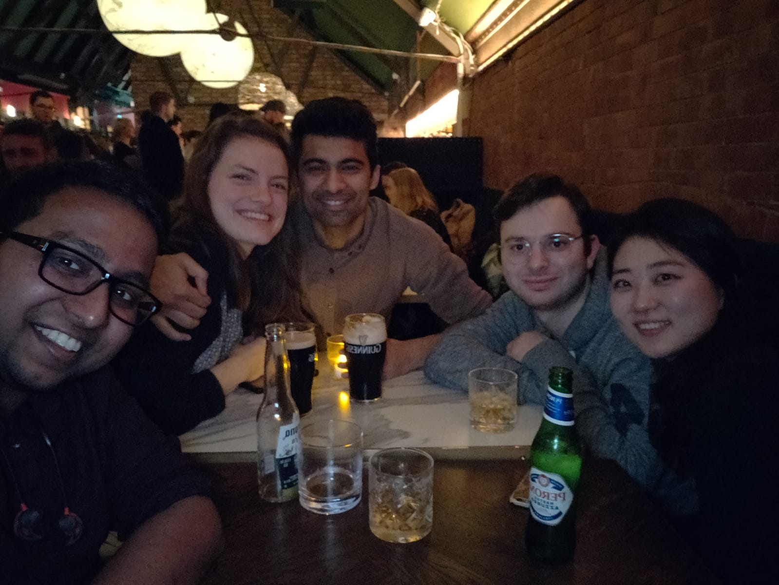







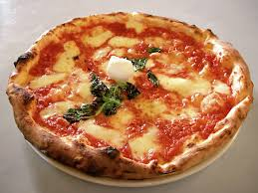
Soft. Engineer (Optum/UHG)
Associate Soft. Engineer (Optum/ UHG)
Derivatives Specialist Associate (State Street Bank)
Data Scientist intern (Optum/UHG)
MSc in Statistics (University College Dublin)
BSc in Statistics, Finance, and Insurance (University of Rome)
Dublin
Roma
Napoli

Slide 3
Word Embeddings and BERT

Slide 4
One-Hot Encoding vs Embeddings
Heart Failure
Congenital heart disease
Anxiety Disorder
Heart Failure
Congenital heart disease
Anxiety Disorder
One-Hot Encoding Approach
Word Embeddings
Notes:
What we usually do in our organisation anytime we have a new use case, we take the data from one of the many claim engines and we build a ML solution for it. The way we preprocess the claim data is usually adopting the traditional feature engineering approaches like one-hot-encoding is one of the most common used in our team. This approach works quite well we want to predict if a claim is a duplicate or not, or if we want to predict some claim fraud detection. However, if we want to study the relationships between claims and within claims, to learn the structure of a claim then the one-hot encoding approach would not be appropriate since we would lose so much information about the data. Because you know if we consider two one-hot encoded vectors representing two claims in the space and we consider the cosine similarity as metric to determine how similar those vectors are the cosine similarity of those vectors would be always equal to 0.
This is the main reason we moved to an embedding approach for this kind of tasks. So Having vectors of numbers representing claims or patients. With word embeddings we would have that the geometric relationships between word vectors reflect the semantic relationships between words. So sentences or claims representing similar things would have similar embedding representations in the space (i.e. would be closer).

Slide 5
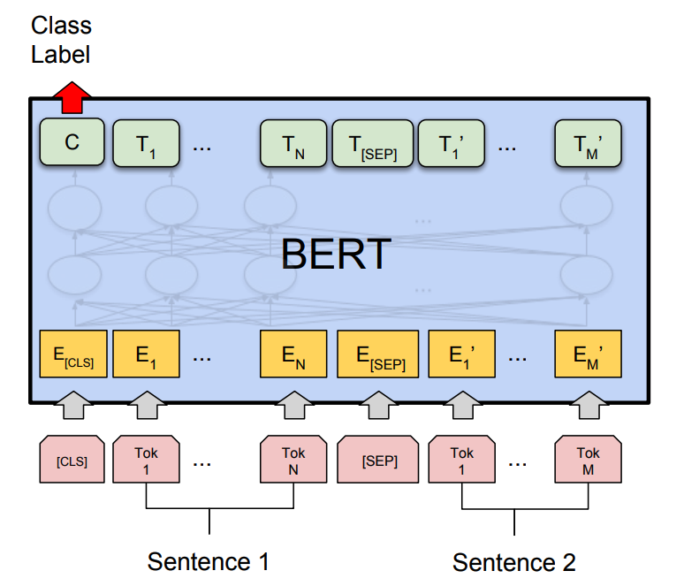

What is BERT?
Bidirectional Encoding from Representational Transformers
Google (2018)
pre-trained deep learning natural language framework

Slide 6

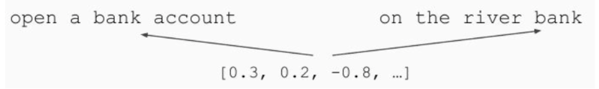
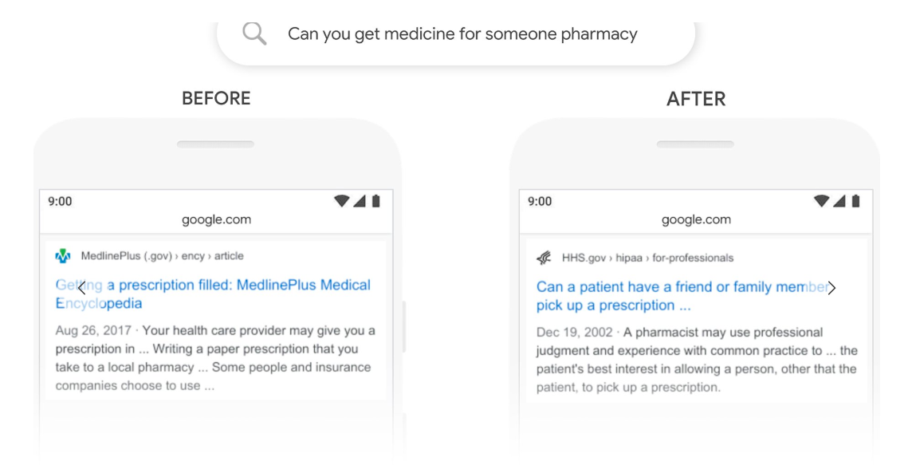
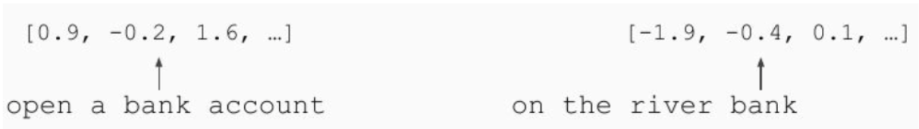
Google: BERT
Trad. Word Embedding approaches
Bert

Slide 7
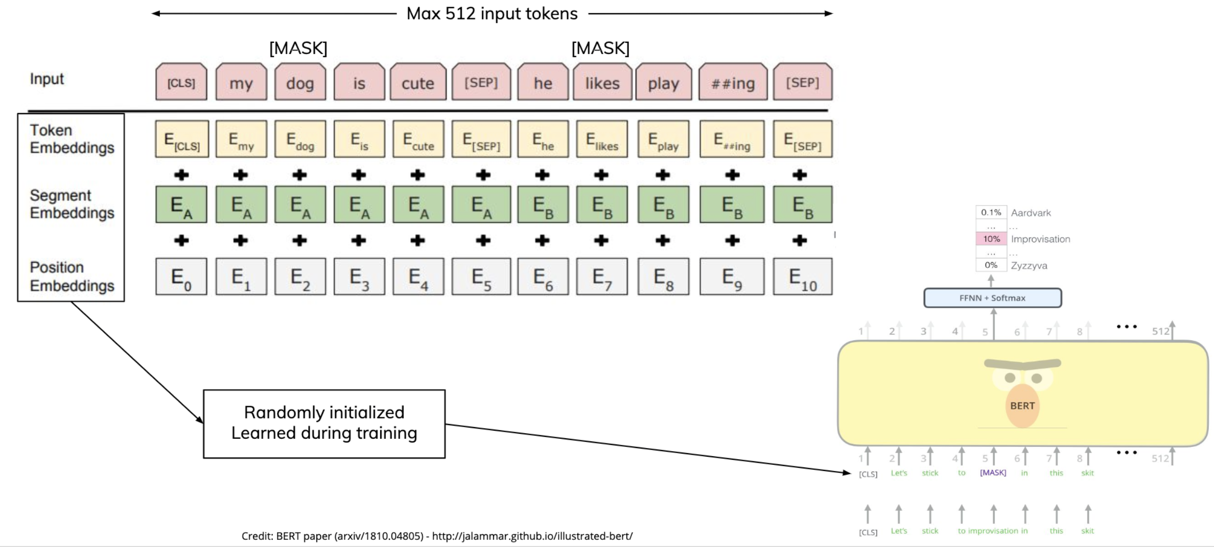
How BERT was trained?
BertForMaskedLM

Slide 8
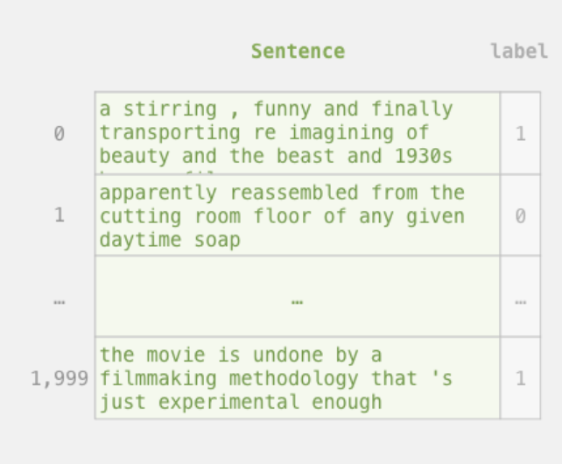
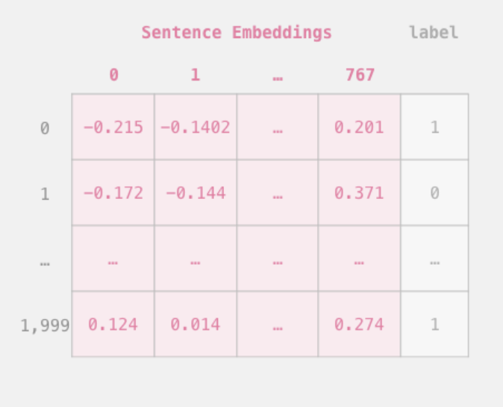
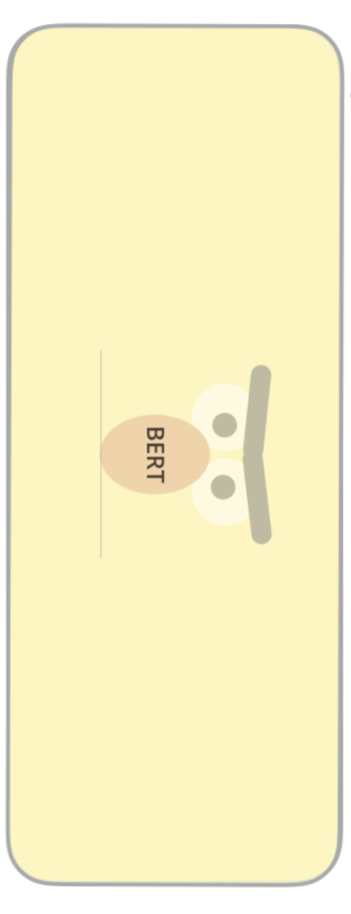
Fine-Tuning with Bert
Pre-trained Bert Model
Source:jalammar.github.io
Notes:
Talk about Kaggle competition on Twitter identifying disaster

Slide 9
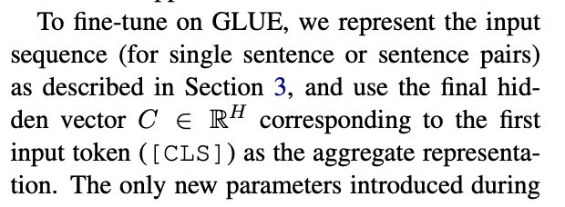
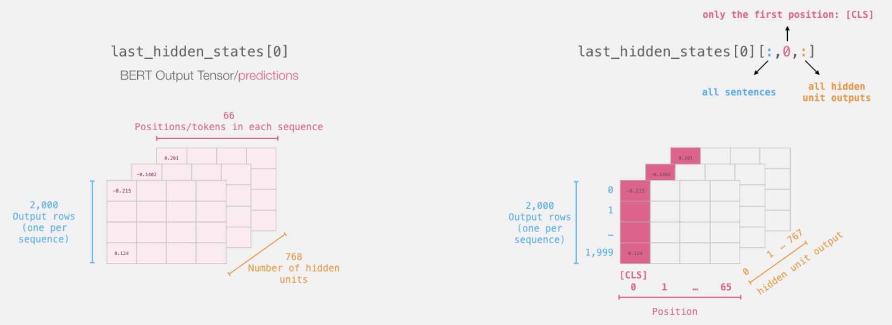
Fine-Tuning with Bert
From Bert paper
Source:jalammar.github.io
Notes:
The General Language Understanding Evaluation (GLUE) benchmark (Wang et al., 2018a) is a collection of diverse natural language understanding tasks.

Slide 10
Thank You
Giorgio Mondauto

Slide 11
APPENDIX

Slide 12
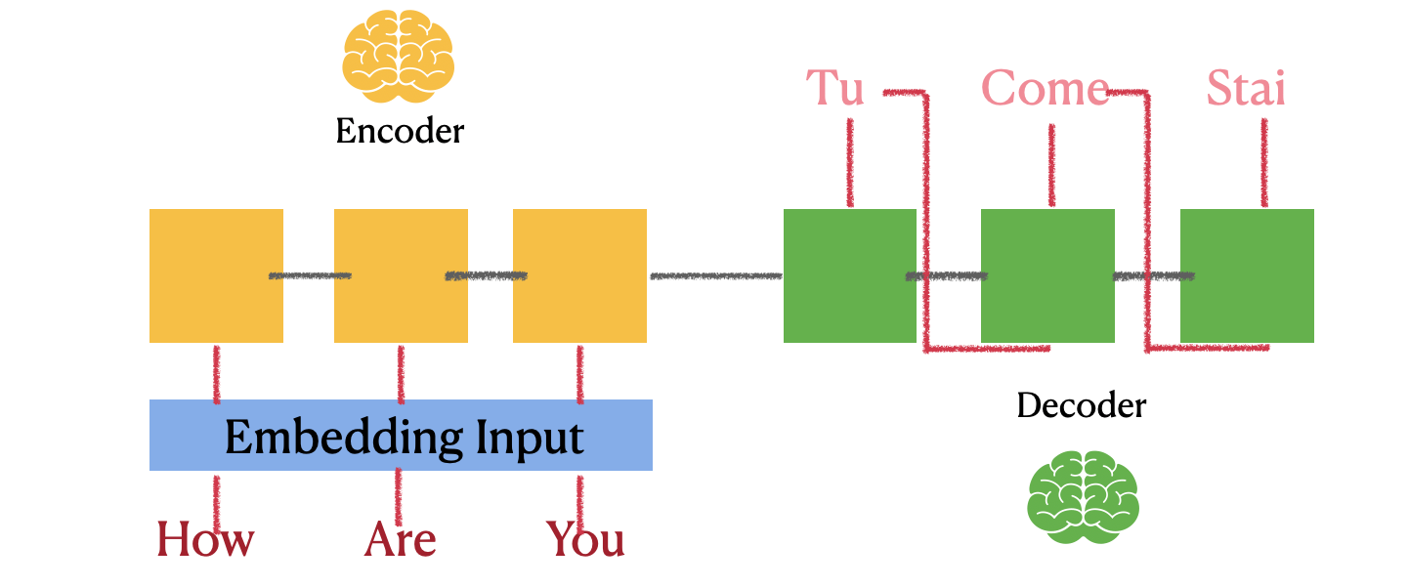
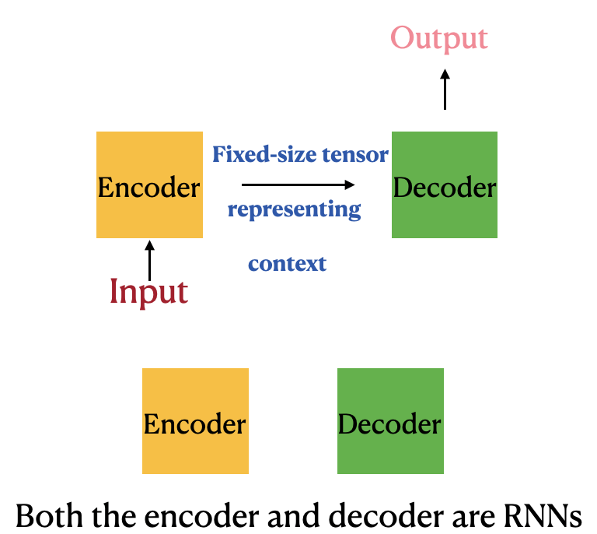
RNN

Slide 13
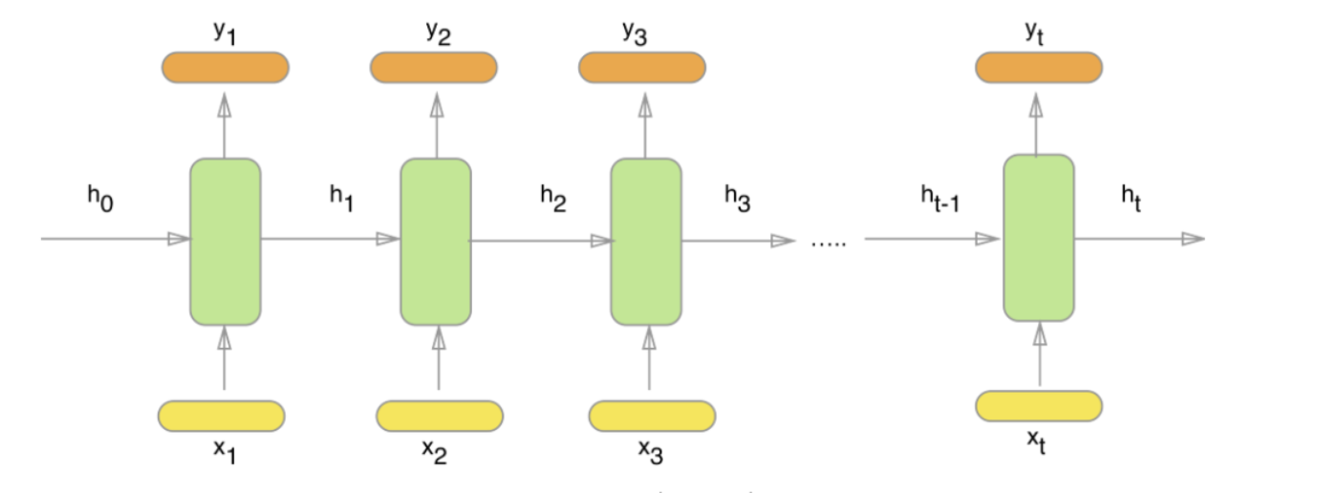
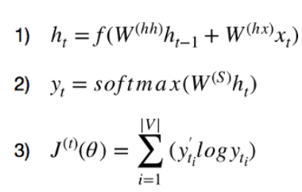
RNN

Slide 14
Transformer
Notes:
The encoder and decoder blocks are actually multiple identical encoders and decoders stacked on top of each other. Both the encoder stack and the decoder stack have the same number of units.
“Self-attention, sometimes called intra-attention, is an attention mechanism relating different positions of a single sequence in order to compute a representation of the sequence.” Self-attention allows the model to look at the other words in the input sequence to get a better understanding of a certain word in the sequence.
First, we need to create three vectors from each of the encoder’s input vectors:
Query Vector
Key Vector
Value Vector.
Next, we will calculate self-attention for every word in the input sequence
The score for the first word is calculated by taking the dot product of the Query vector (q1) with the keys vectors (k1, k2, k3) of all the words
Then, these scores are divided by 8 which is the square root of the dimension of the key vector:
Next, these scores are normalized using the softmax activation function:
These normalized scores are then multiplied by the value vectors (v1, v2, v3) and sum up the resultant vectors to arrive at the final vector (z1). This is the output of the self-attention layer. It is then passed on to the feed-forward network as input
So, z1 is the self-attention vector for the first word of the input sequence “Action gets results”. We can get the vectors for the rest of the words in the input sequence in the same fashion
self-attention is computed not once but multiple times in the Transformer’s architecture, in parallel and independently. It is therefore referred to as Multi-head Attention. The outputs are concatenated and linearly transformed
Limitations of the Transformer
Transformer is undoubtedly a huge improvement over the RNN based seq2seq models. But it comes with its own share of limitations:
Attention can only deal with fixed-length text strings. The text has to be split into a certain number of segments or chunks before being fed into the system as input
This chunking of text causes context fragmentation. For example, if a sentence is split from the middle, then a significant amount of context is lost. In other words, the text is split without respecting the sentence or any other semantic boundary

Slide 15
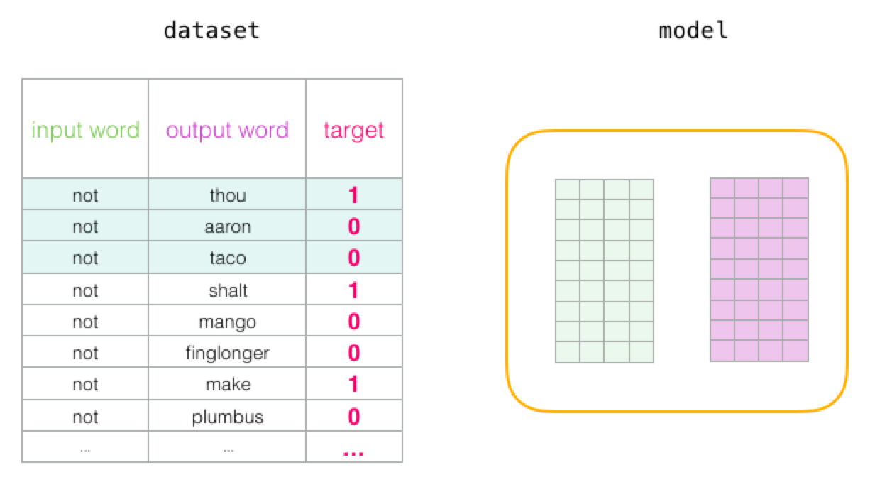
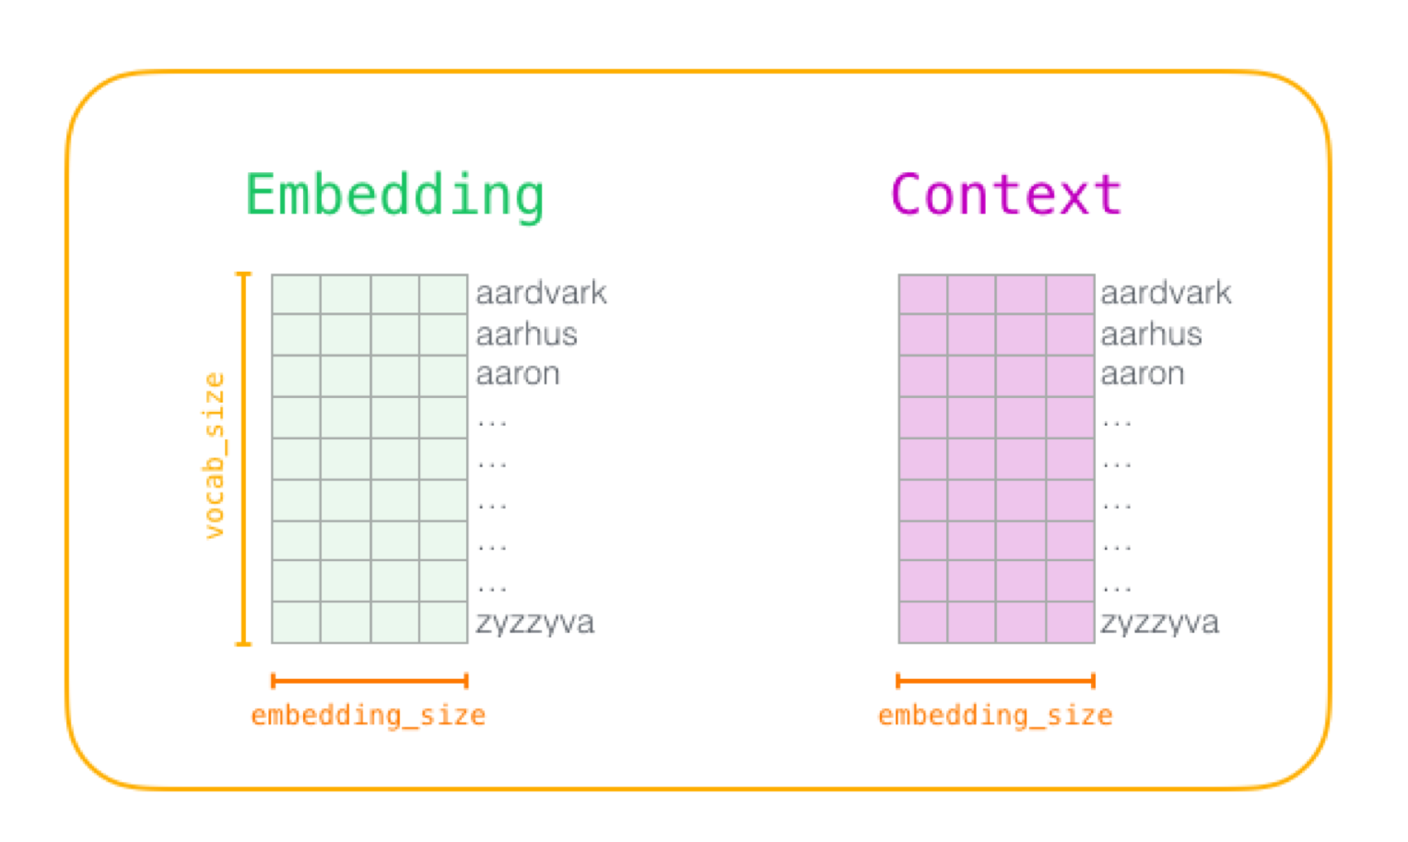
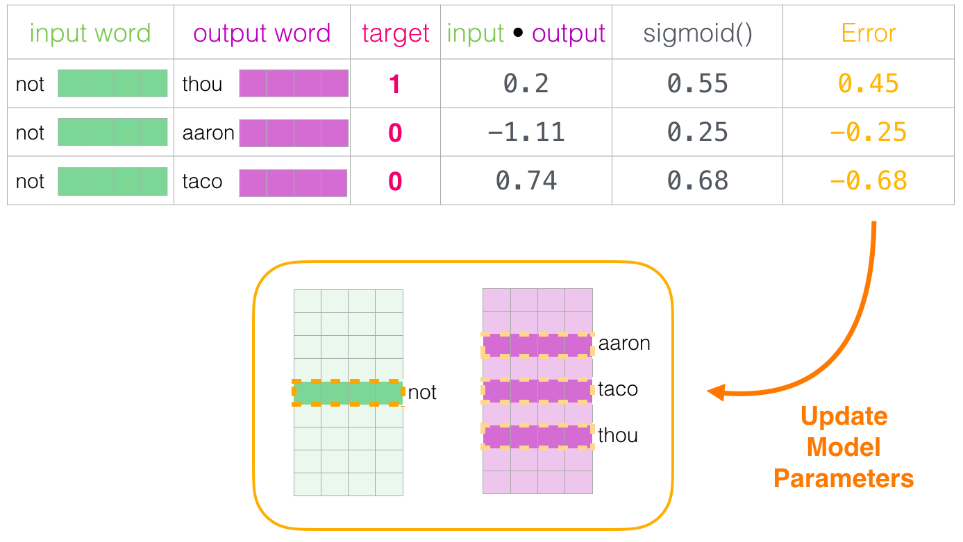
Word2Vec
Thou shalt not make ..
Source:jalammar.github.io

Slide 16
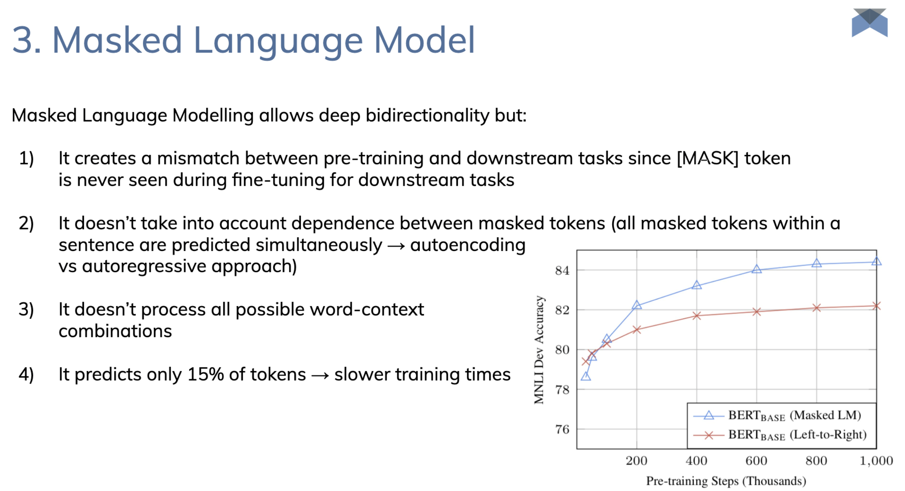
Source: Deep Learning Italia

Slide 17
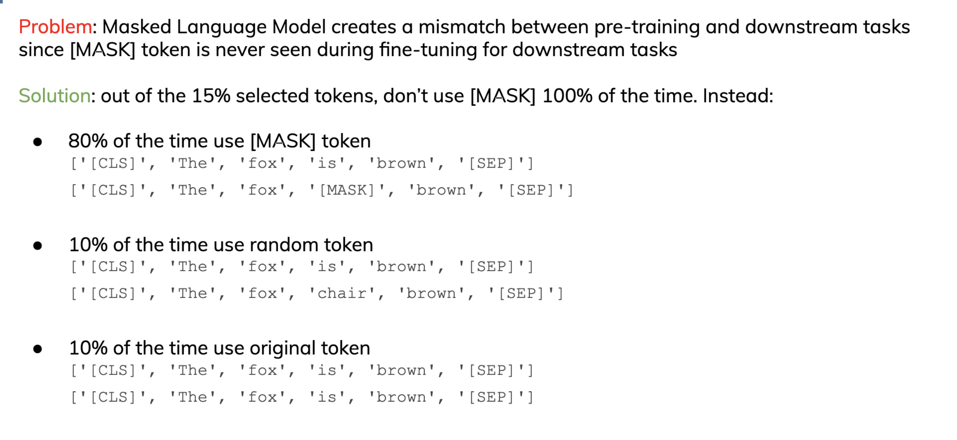
Source: Deep Learning Italia

Slide 18
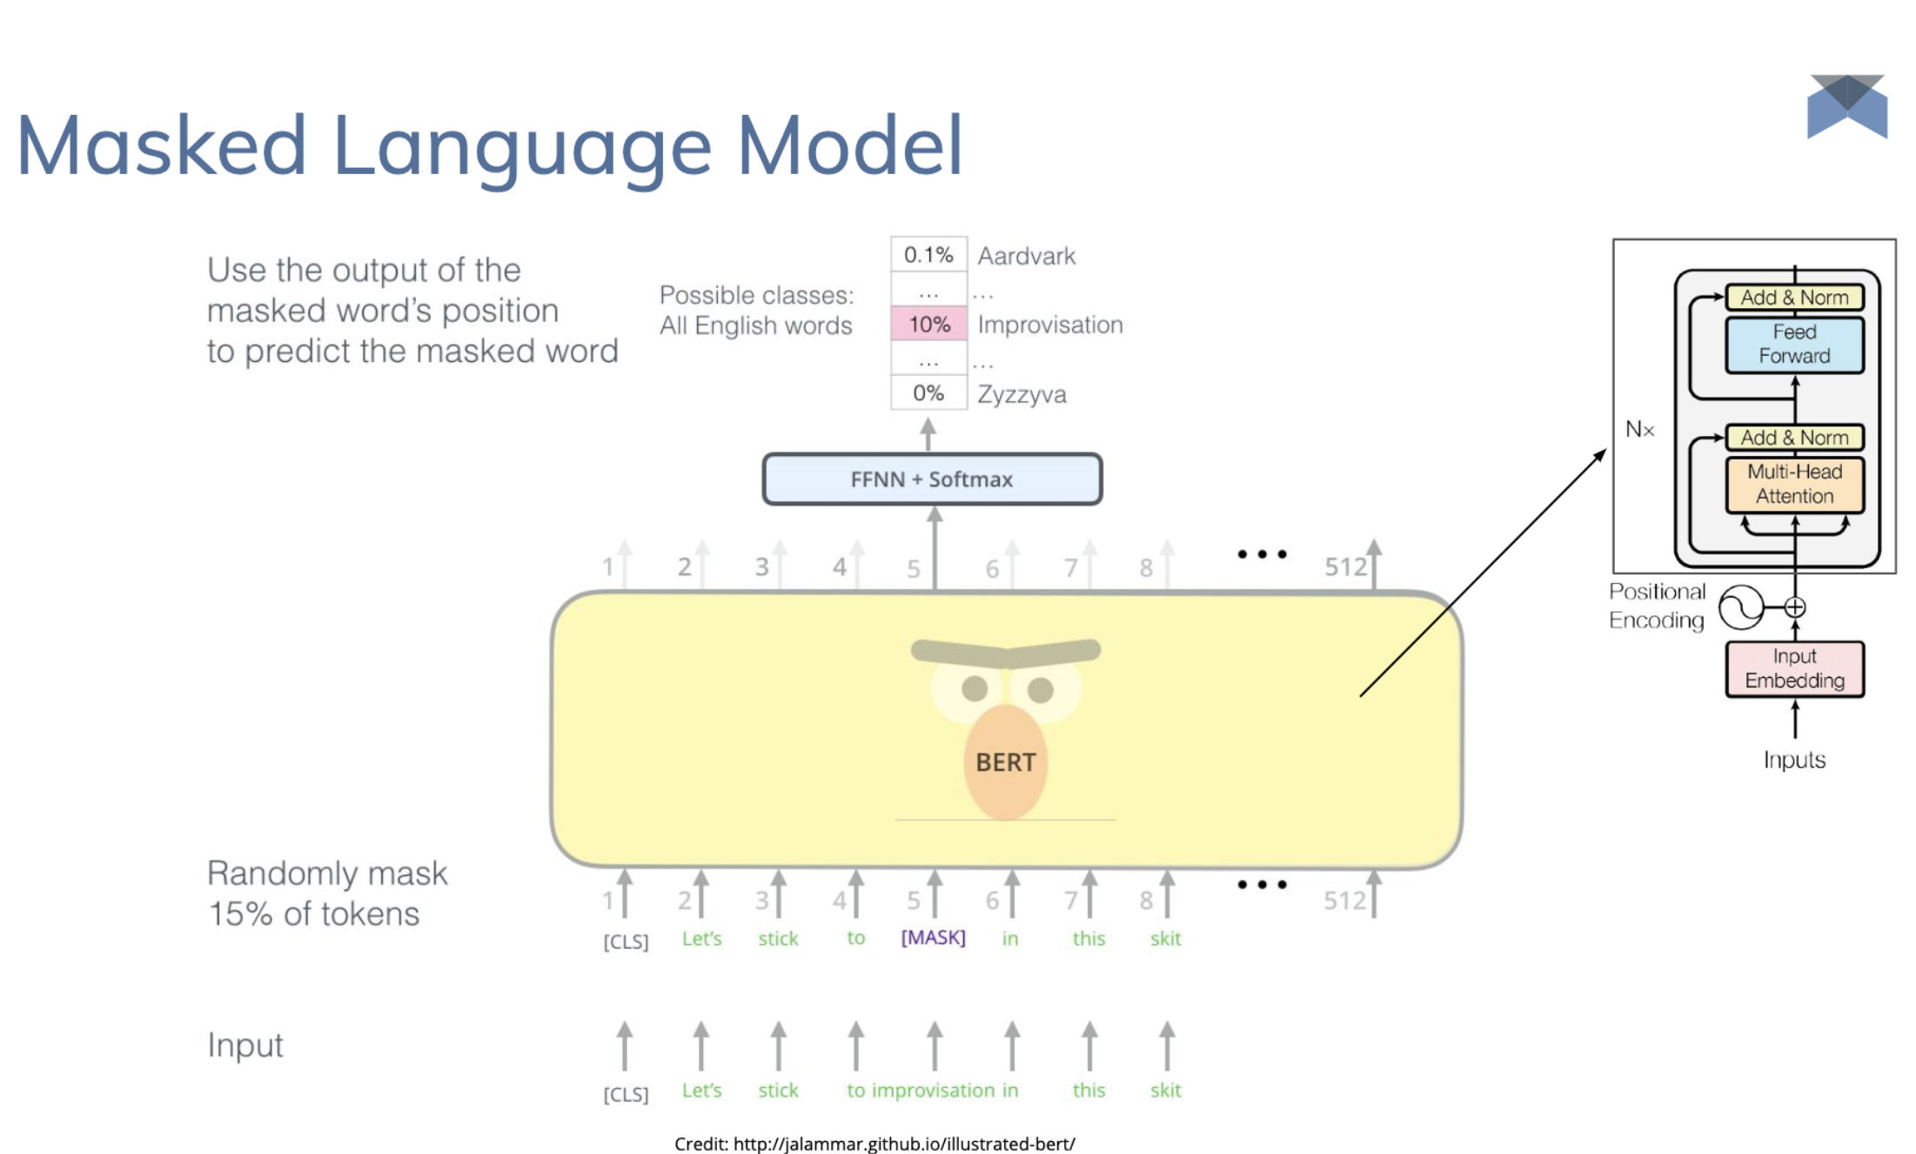

Slide 19
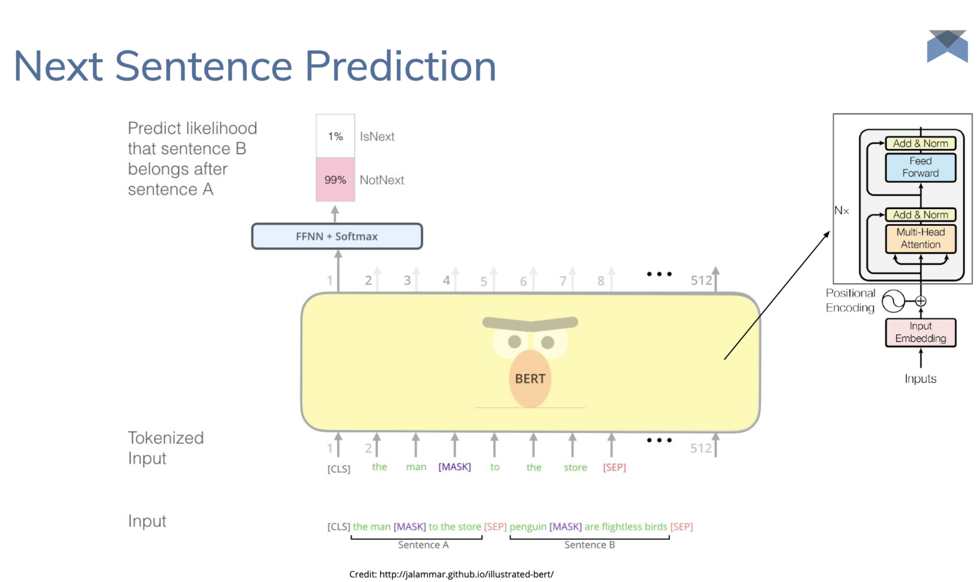

Slide 20
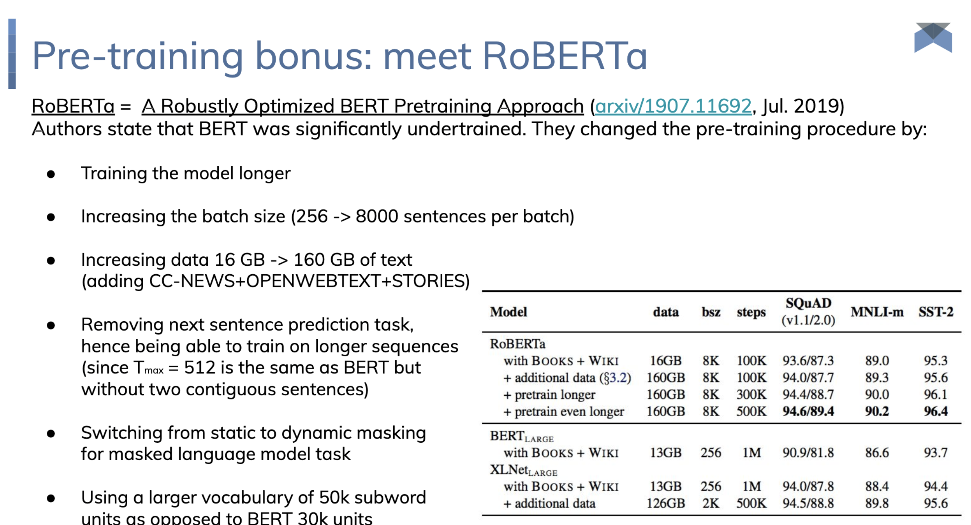
Source: Deep Learning Italia

Slide 21
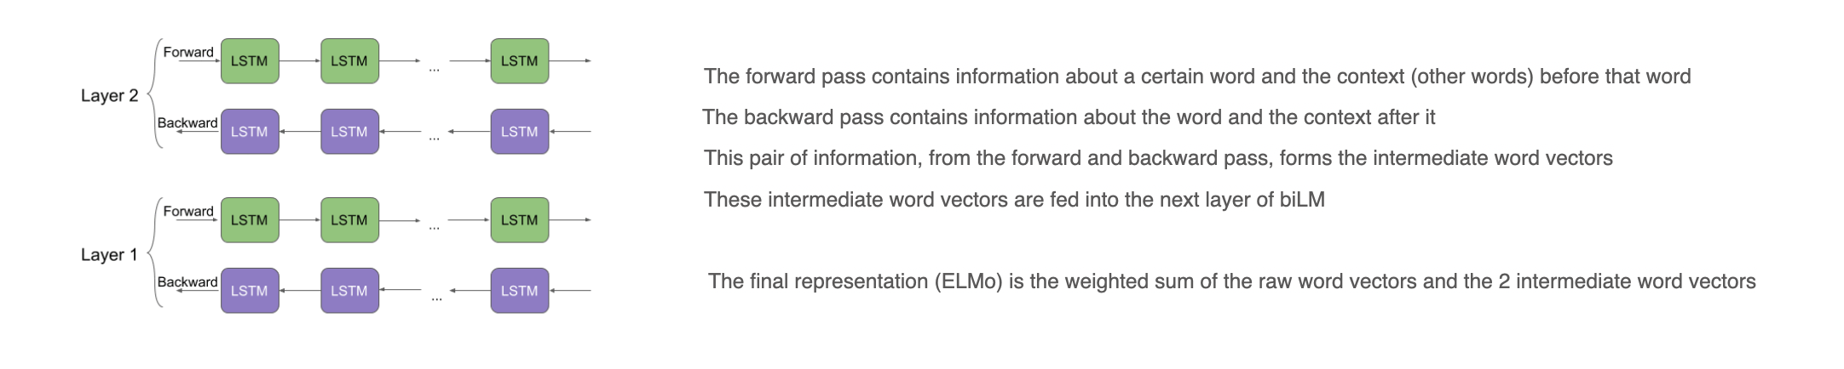
Elmo

